Slide 1
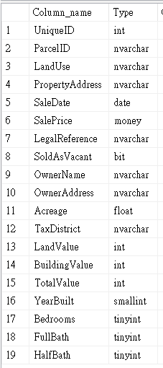
Dataset Description
Nashville Housing ETL Project
SQL ETL + Power BI Visualization
<< Table Schema
This dataset contains information about housing sales in Nashville, TN.
Size: 56,478 rows / 19 columns
Source: https://www.kaggle.com/datasets/bvanntruong/housing-sql-project/data
陳逸 Rachel Chen

Slide 2
Question Design
Goal
Clean and transform the Nashville housing data to prepare for further analysis, and create a stored procedure for data cleaning.
Visualize the data to simplify understanding and highlight trends in property sales by year and location.
>> Columns Used: UniqueID, LandUse, PropertyAddress, SaleDate, SalePrice, Acreage, LandValue, BuildingValue, TotalValue
Tools used in this project
Programming Language: SQL
ETL Process: Extract → Transform → Load
Stored Procedure for Data Cleaning
Visual: Power BI

Slide 3
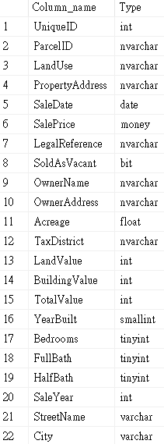
ETL Process
Table Schema >>
(after transformation)
Extract
Imported data into MS SQL database.
Transform
Cleaned Data
-- Changes SaleDate to a standard DATE format
-- Adds a new column SaleYear
-- Splits PropertyAddress into StreetName and City
-- Adds new columns for StreetName and City
-- Removes NULL values from the PropertyAddress column
Size after transformation: 56,478 rows / 22 columns
Load
Loaded data into Power BI and executed visualizations.

Slide 4
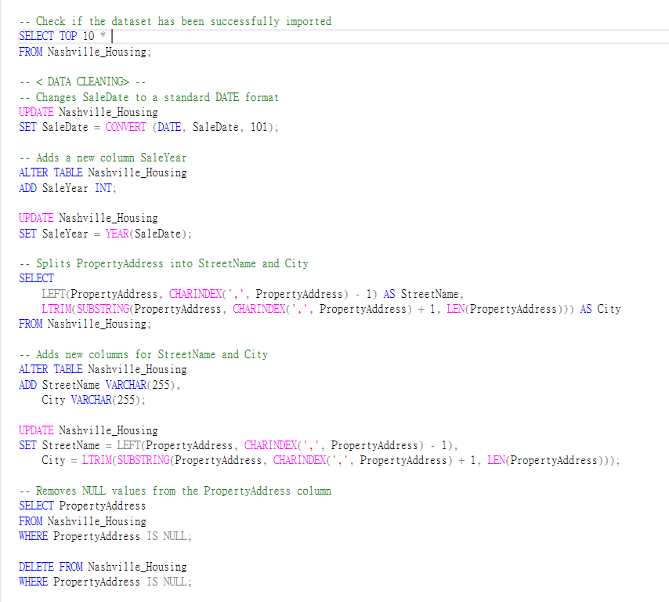
Code (MS SQL)

Slide 5
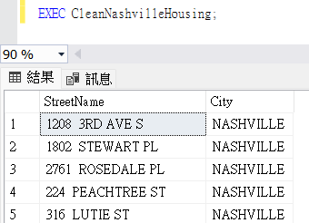
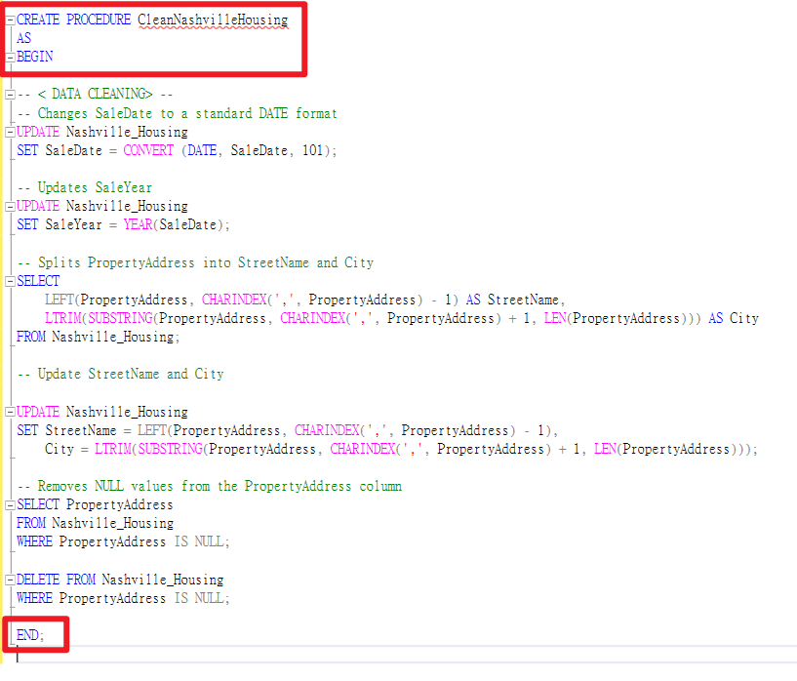
Data Cleansing Procedure
Stored Procedure
-- Changes SaleDate to a standard DATE format
-- Updates SaleYear
-- Splits PropertyAddress into StreetName and City
-- Update StreetName and City
-- Removes NULL values from the PropertyAddress column

Slide 6
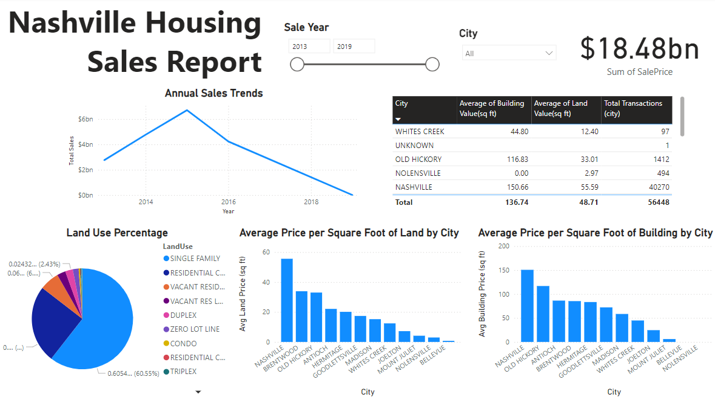
Visualization
Description
Slicer:
Sales Year and City
Annual Sales Trend:
Utilized a line chart to display the sales trend from 2013 to 2019.
Land Use Percentage:
Showed the overall land use distribution, with land use classified by city using a pie chart.
Average Price of Land (Building)
by City (per square foot):
Used column charts to compare the average land (building) price across different cities.
Table:
Displayed the overall information in a table format.

Slide 7
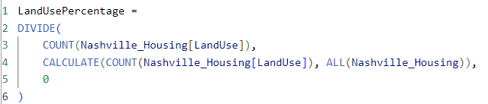
DAX (Power BI)

